Slide 1
Day Trade Bot
Pain Points:
Intraday trading, trader faces difficulties to scan through numerous number of tickers to identify what is a good setup to enter
Often enough, it is very difficult to monitor and key track on those tickers that posses clean/good setup to enter based on the various day-trade methods (e.g. Triple EMA, EMA9 + VWAP combo and VWAP retest)
Objectives:
Create a program that is able to pull live tickers’ data, apply the various indicators to analyse feasible day trade setup (LONG / SHORT)
The program should be able identify tickers that meet the criteria for Triple EMA, EMA9 + VWAP combo and VWAP retest
Future iterations, the program should automatically analyse if the risk (~ <1%) is feasible to enter, across reference to 1hour charts (EMA20, MA50, MA100) for key levels. Different chart intervals. Backtest across historical data to under which day trade method perform better.

Slide 2
Day Trade Bot Iteration Plan
v1.0 Features (27/03/2022)
Take in a list of tickers, pull live data and calculate the various indicators (EMA9, EMA13, VWAP), 3min Charts ✓
Apply Triple EMA method ✓ (Up to rule two)
Apply EMA9 + VWAP combo ✓
Apply VWAP Retest ✓
Periodically output the list of tickers that have a feasible setup based on the 3 day trade methods ✓
Work Flow
At market start (9.30am), trader run the program
Periodically look at the output of the program for tickers
In tradingview.com, pull out the ticker’s chart visually verify if it meets the conditions for the day trade method.
Apply the necessary analysis (e.g. cross reference with SPY, stop-loss, risk, position sizing) and determine if it’s feasible to enter the trade)
Go to brokerage platform and place the trade
Trader executes personal judgement to understand when to take profit
v1.01 Features
Backtest the various methods
Analyze Profits
v1.02 Features
Dashboard to visualize the possible setups
Able to calculate the stop loss
Analyse if the risk is too big
Calculate position sizing
Cross reference with SPY and key levels
Work Flow
At market start (9.30am), trader run the program
Periodically look at the output of the program for tickers
In tradingview.com, pull out the ticker’s chart visually verify if it meets the conditions for the day trade method.
Based on the additional information provided (e.g. position sizing and maybe limit price/market), the trader will place the trade on the brokerage platform
Trader executes personal judgement to understand when to take profit

Slide 3
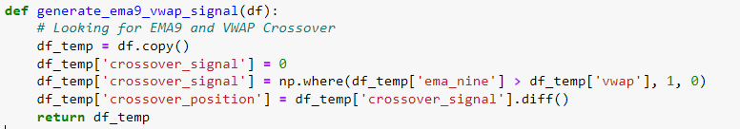
EMA9 + VWAP combo
Method:
Check for EMA9 and VWAP crossover. If EMA9 crosses above VWAP = LONG; Else EMA9 crosses below VWAP = SHORT
‘crossover_position’ = 1, means EMA9 crosses above VWAP
‘crossover_position’ = -1, means EMA9 crosses below VWAP
‘crossover_position’ = 0, means no crossing below EMA9 and VWAP

Slide 4
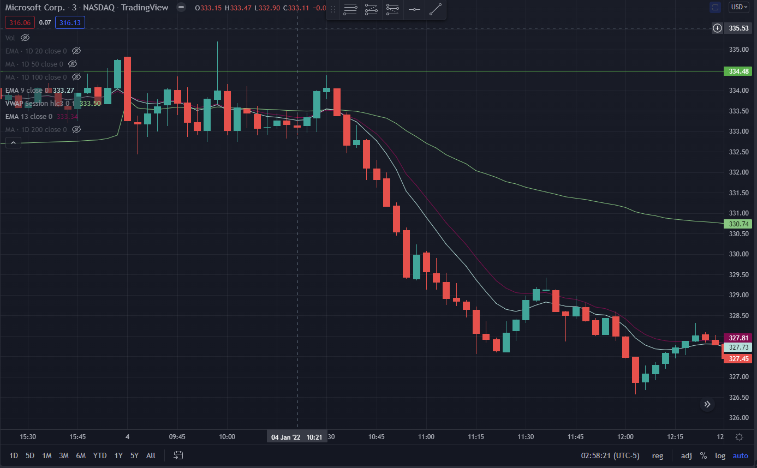
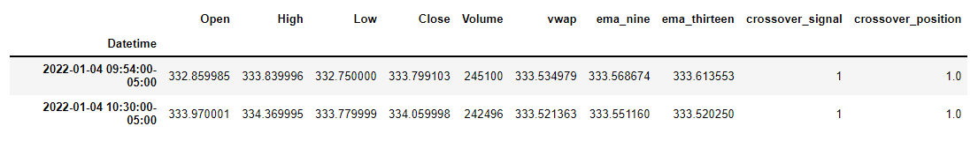
EMA9 + VWAP combo Long Results
Date: 04/01/2022
Ticker: MSFT
Comments:
The algorithm is able to detect the Long crossover signal.

Slide 5
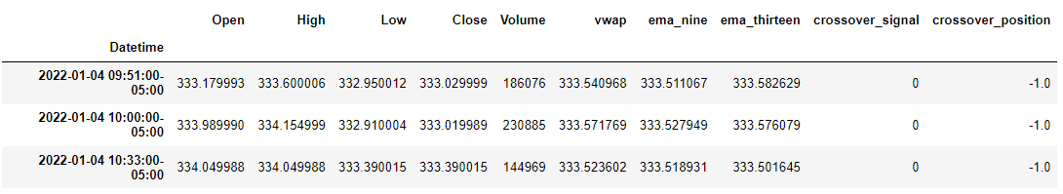
EMA9 + VWAP combo Short Results
Date: 04/01/2022
Ticker: MSFT
Comments:
The algorithm is able to detect the Short crossover signal.

Slide 6
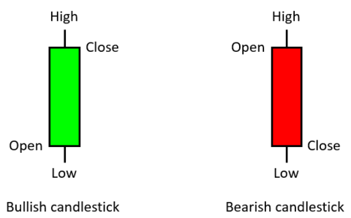
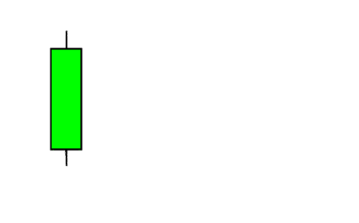
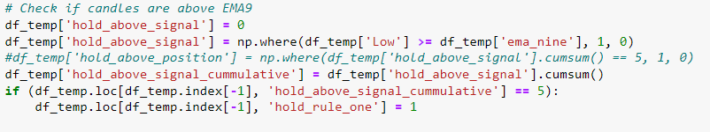
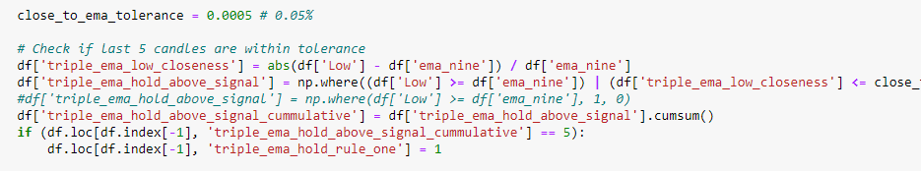

Triple EMA
Method:
Rule 1
Check if last 5 candles (including wicks) are above or below EMA9 or within certain thresholds 0.05%
For Long, compare if candle’s low is above EMA9
Whereas for Short, compare if candle’s High is below EMA9
‘hold_rule_one’ is used to indicate if last 5 candles are above or below.
1 for Long, -1 for Short, 0 for not applicable
Assumption:
What is consider above? For now the candle’s low must be equals or above.
In the future (Rule 1), we can consider adding a tolerance threshold as to if the wick crosses the EMA9 slightly
Rule 1
EMA9
0.05% tolerance
threshold
Revised Rule 1
22/01/2022

Slide 7
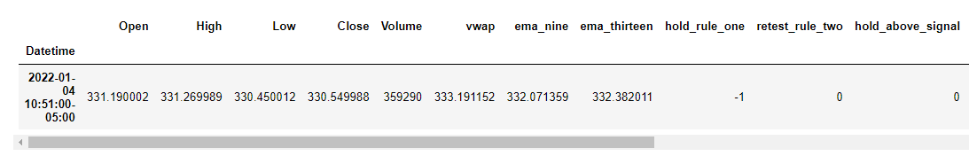
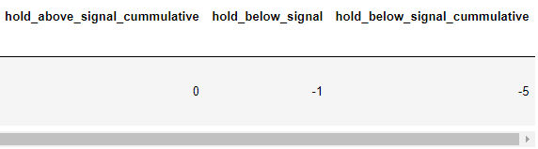
Triple EMA Short Rule 1 Results
Date: 04/01/2022
Ticker: MSFT
Comments:
The algorithm is able to at 10:51 there is 5 candles below EMA9
‘hold_rule_one’ = -1

Slide 8
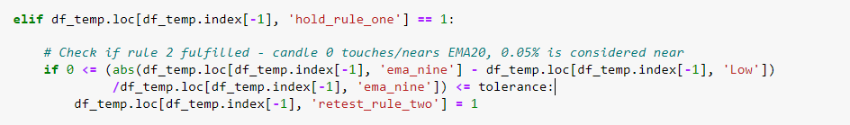
Triple EMA
Method:
Rule 2
Check if the last candle (out of the 5) is retesting EMA9.
Retest means that it’s close / bounce off EMA9
A tolerance threshold is defined to allow the candle to bounce off EMA9 instead of requiring it to be entirely above
Assumption:
EMA9
Rule 2
0.05% tolerance
threshold
Rule 2

Slide 9
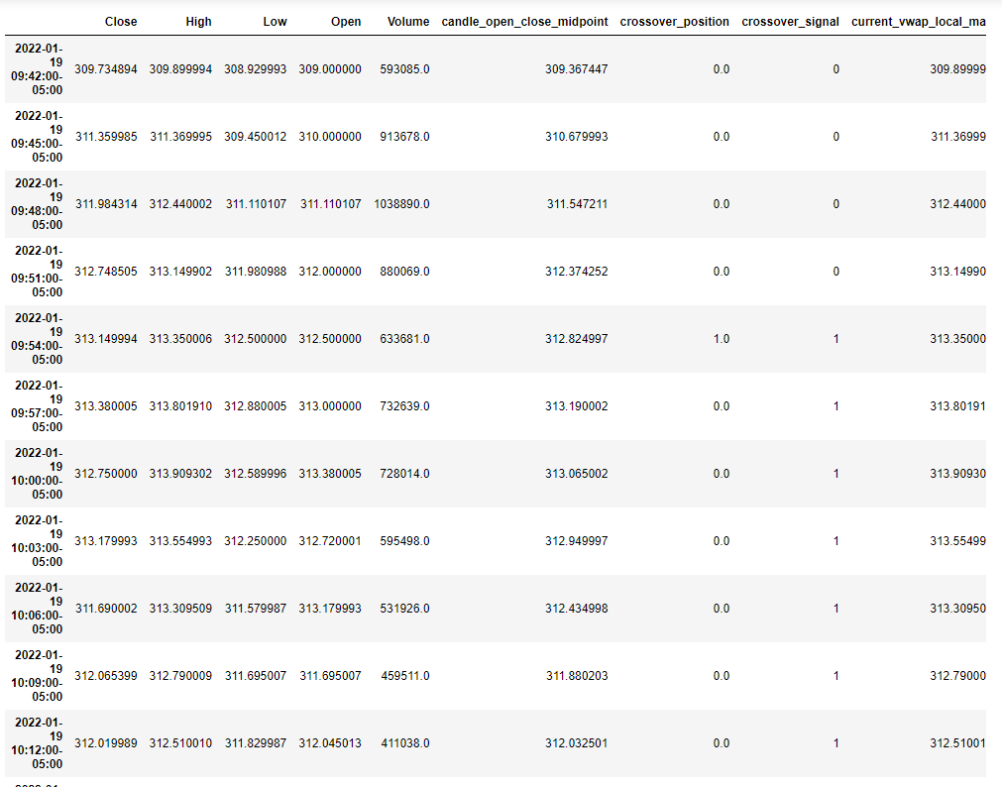
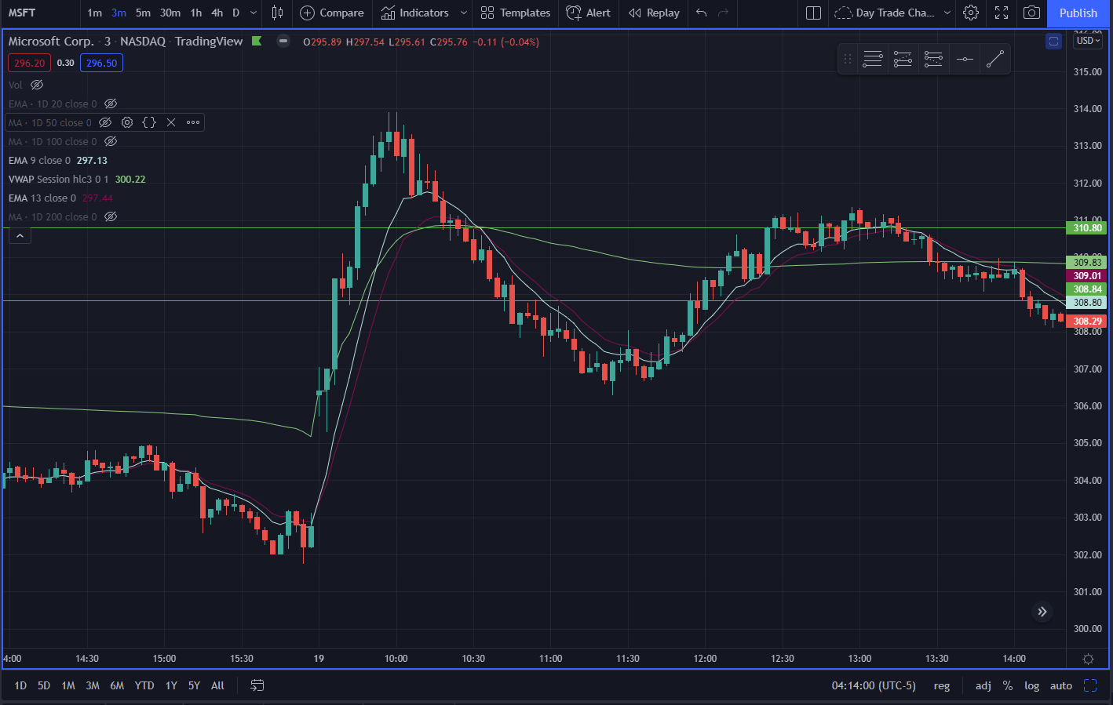
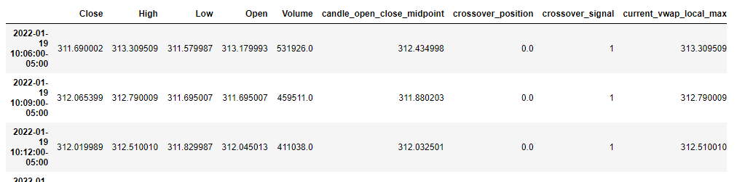
Triple EMA LONG Revised Rule 1 Results
Comments:
The algorithm is able detect a series of 5 candles above EMA9
'triple_ema_hold_rule_one' = 1
As the algorithm is able to detect retest at EMA9.
result_df.loc[result_df['triple_ema_hold_rule_one'] == 1]
Date: 19/01/2022
Ticker: MSFT
With a tolerance test, we are able to detect this retest of EM9 even if the low of the candle is below EMA9.
result_df.loc[result_df['triple_ema_retest_rule_two'] == 1]

Slide 10
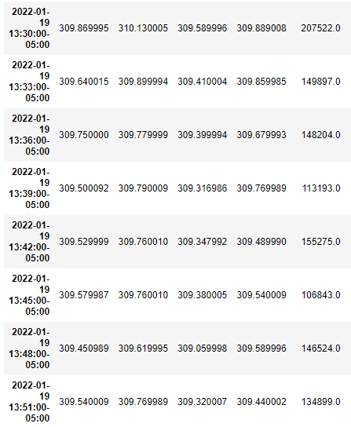
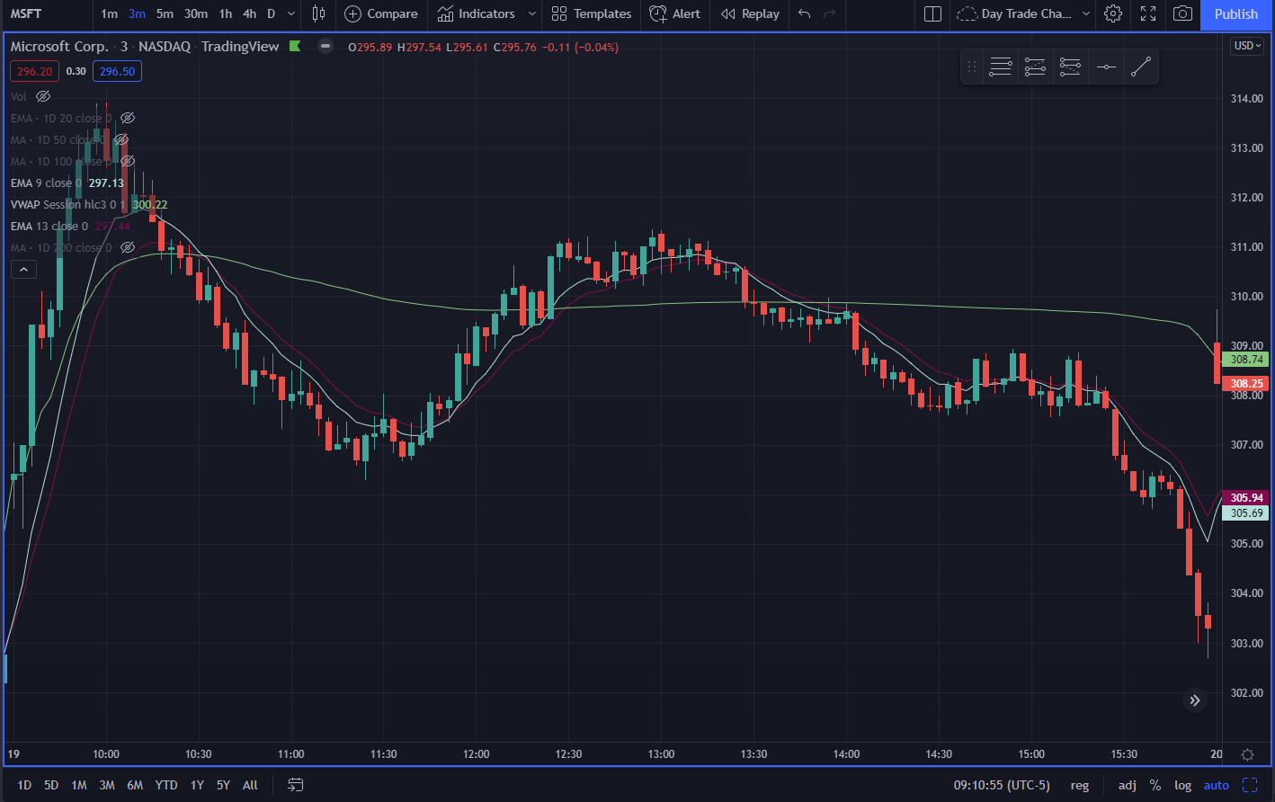
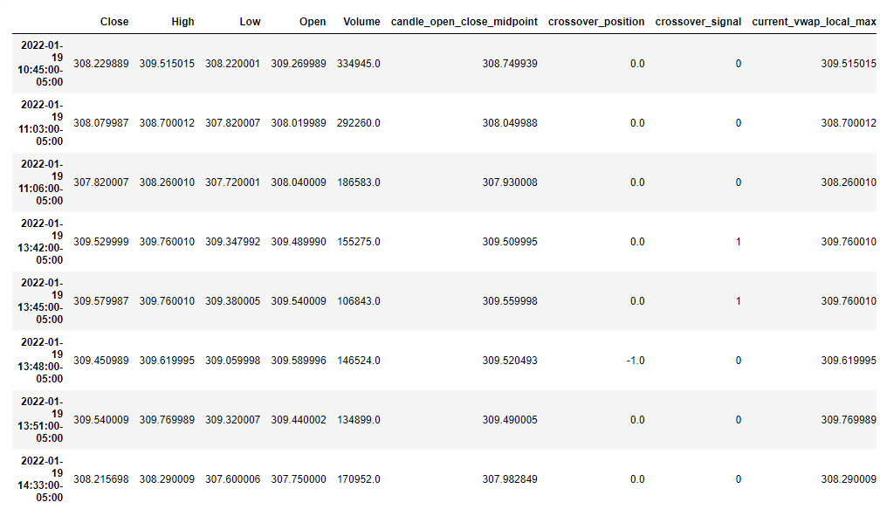
Triple EMA SHORT Revised Rule 1 Results
Comments:
The algorithm is able detect a series of 5 candles below EMA9
'triple_ema_hold_rule_one’ = -1
As the algorithm is able to detect retest at EMA9.
result_df.loc[result_df['triple_ema_hold_rule_one'] == -1]
Date: 19/01/2022
Ticker: MSFT
result_df.loc[result_df['triple_ema_retest_rule_two'] == -1]

Slide 11
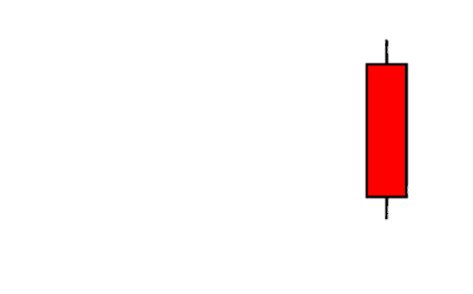
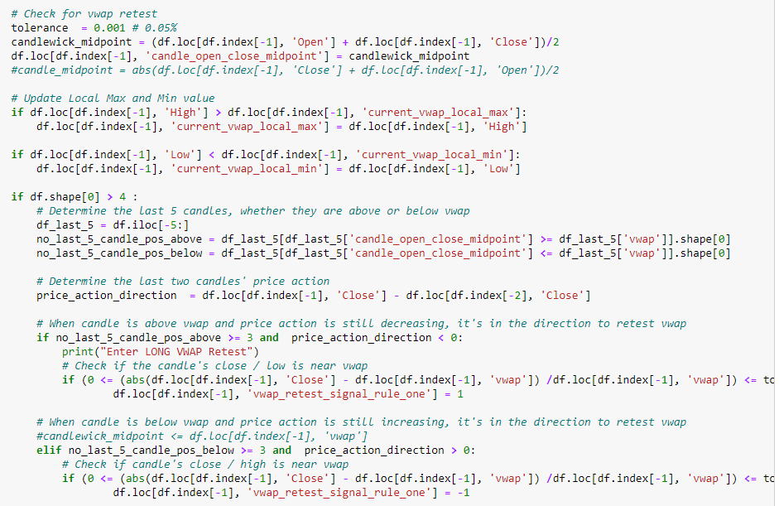
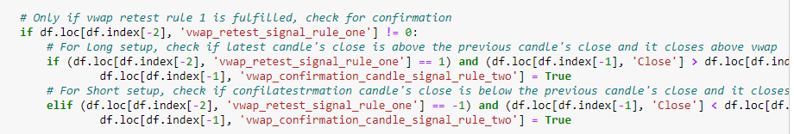
VWAP Retest
VWAP
Method:
Rule 1 Vwap Retest – Candle coming close to VWAP Rule 1
Calculate the number of candles (in last 5) whether they were above or below the vwap
Calculate the last two price action is it downtrend or uptrend
Check whether the candle’s close /low (LONG) or close/high (SHORT) is near vwap with certain tolerance
'vwap_retest_signal_rule_one’ = 1 (LONG)
'vwap_retest_signal_rule_one’ = -1 (SHORT)
Rule 2 Confirmation Candle
Check if previous candle’s has fulfilled rule 1: 'vwap_retest_signal_rule_one’ = 1/-1
(LONG) Check if latest candle’s close is greater than the previous candle’s close
(SHORT) Check if latest candle’s close is smaller than the previous candle’s close
0.2% tolerance
threshold
Rule1
Rule2

Slide 12
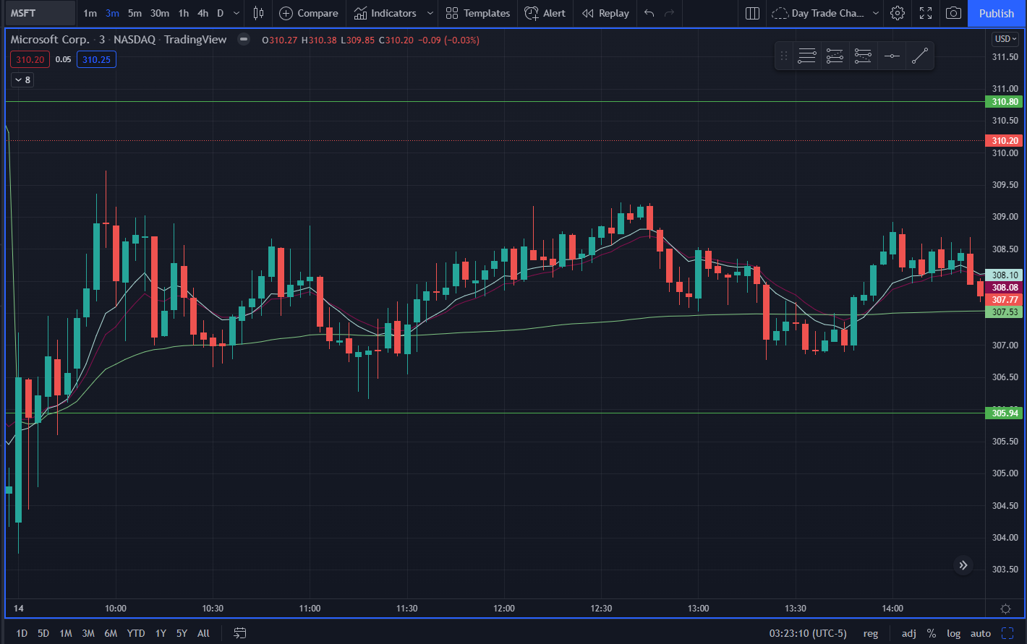
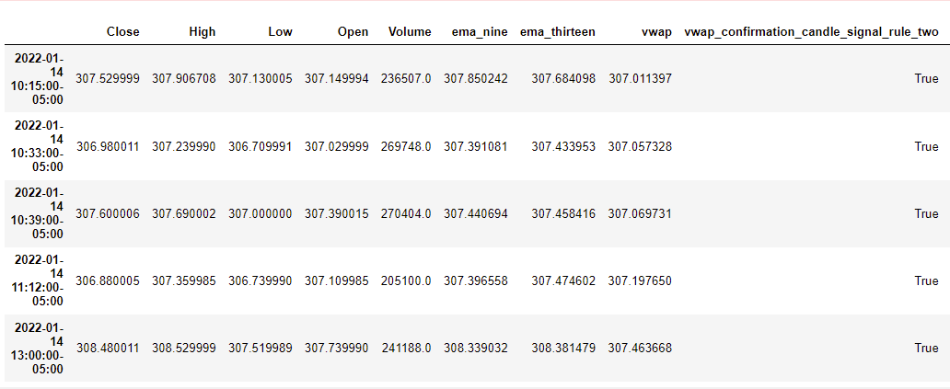
VWAP Retest Edge Cases
Comments:
The vwap confirmation candle signal has detected a false confirmation has the detection logic doesn’t take into account the direction of the price action.
In this case, the price action is a downtrend for a vwap retest to enter LONG instead of a SHORT

Slide 13
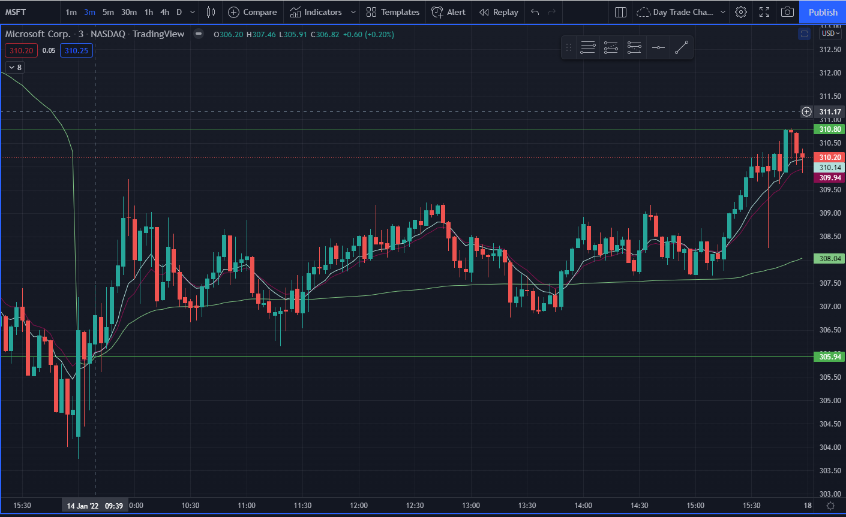
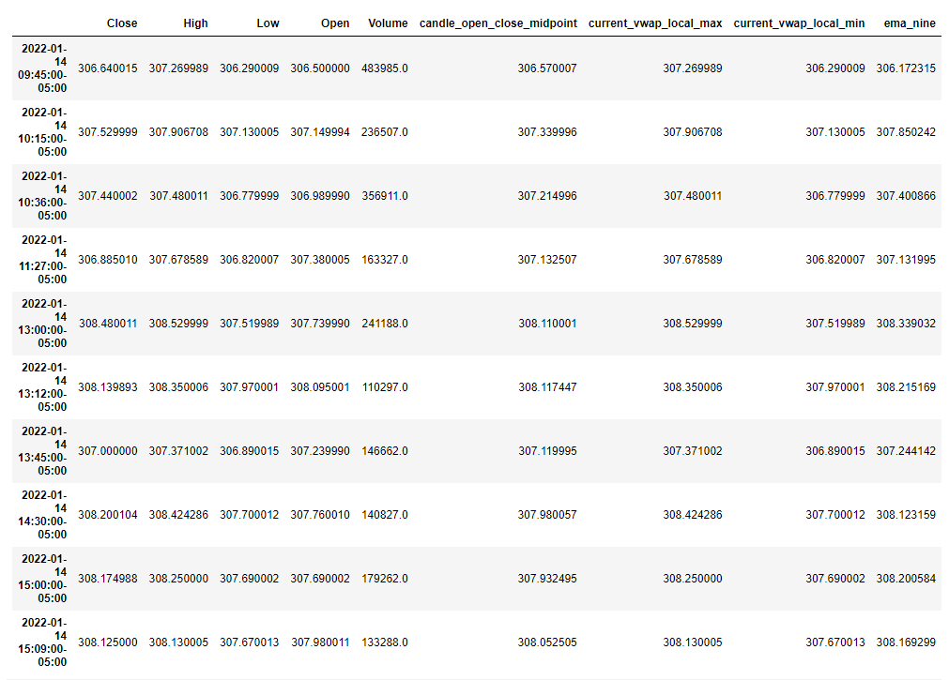
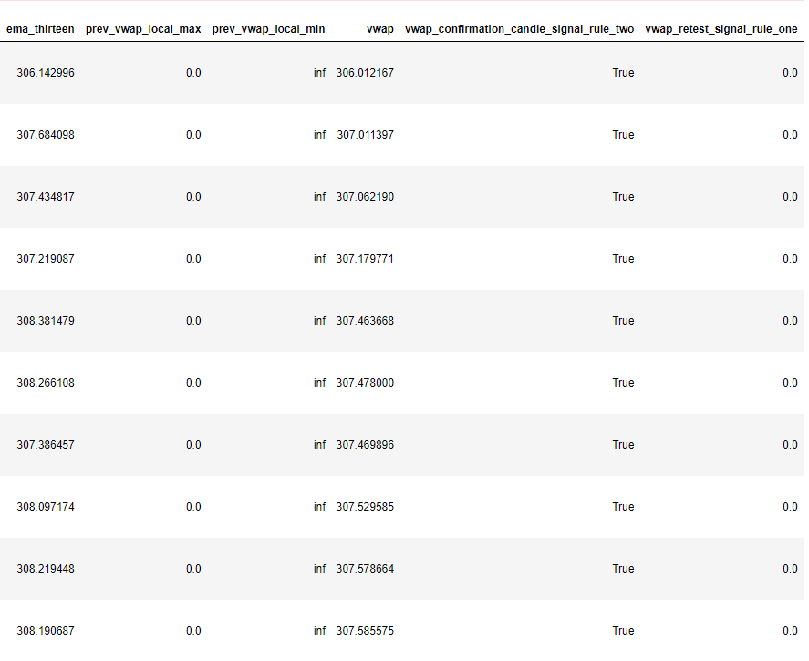
LONG VWAP RETEST
Date: 14/01/2022
Ticker: MSFT
Comments:
Green numbers indicates that the algorithm detect correct vwap retest with confirmation candle
Red numbers indicates that the algorithm is detecting the wrong setup (Need to improve on this)
6
5
8
9
10
2
3
4 Algo detect this as a short setup with confirmation. Need to handle such cases where price action hover between vwap before swinging high again
7 Similar to item 4, algo detect this as a short setup with confirmation
1
Algo works fine. Can filter such cases by time
1
2
3
4
5
6
7
8
9
10

Slide 14
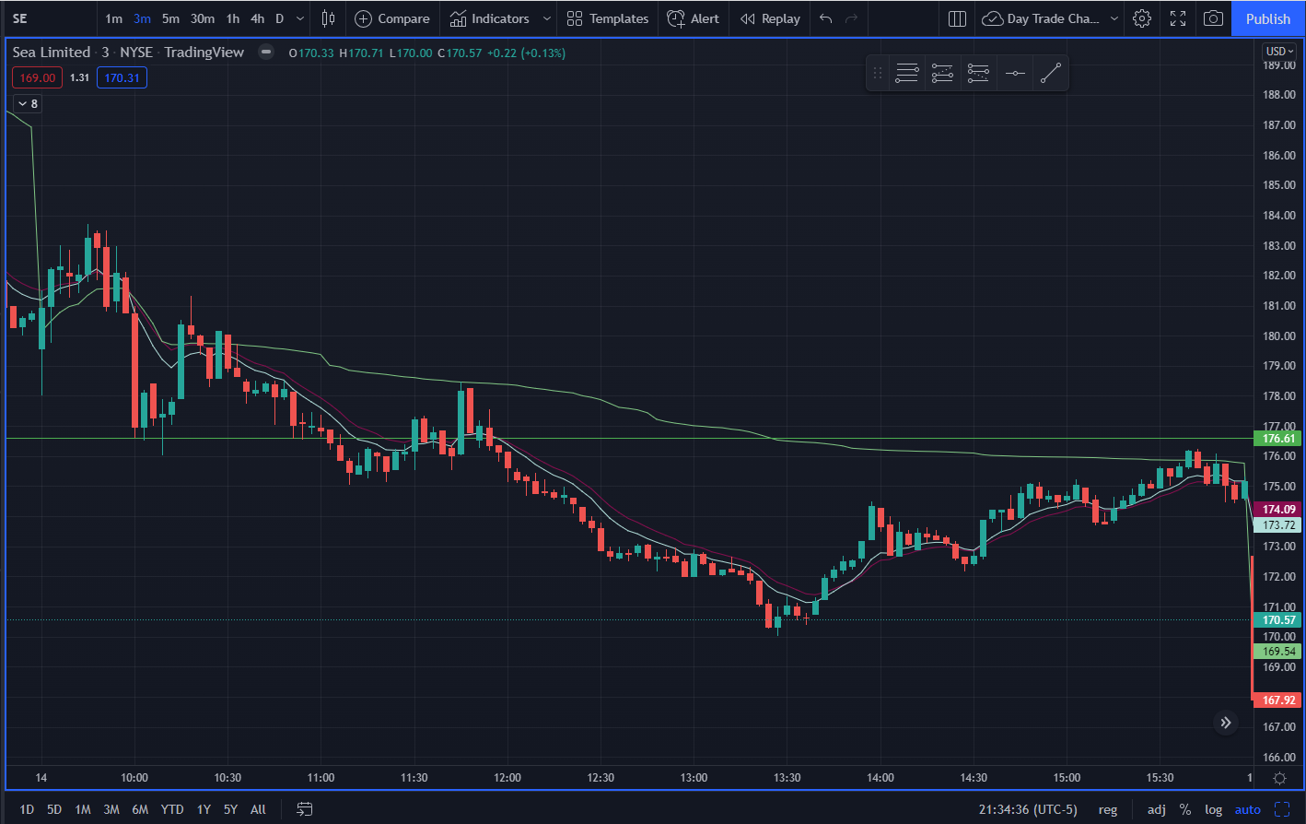
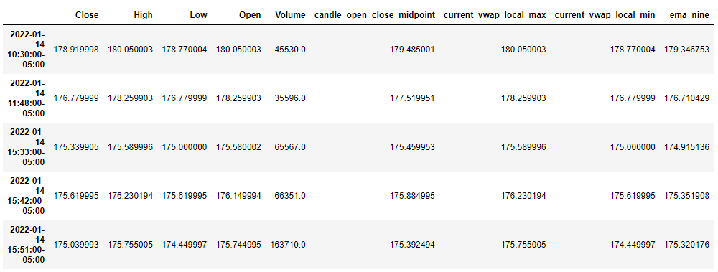
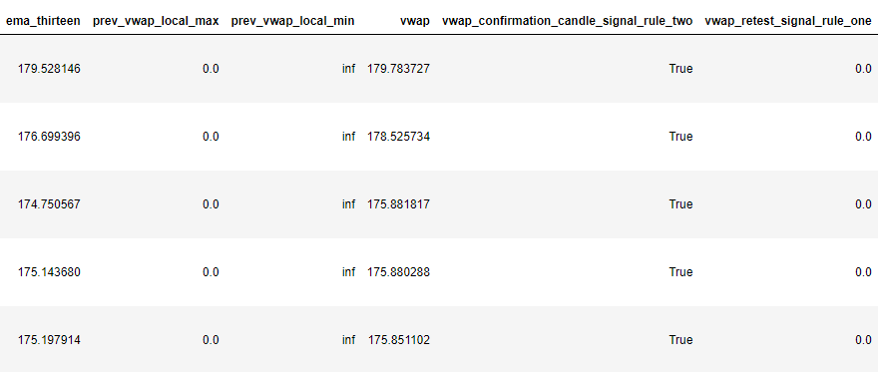
SHORT VWAP RETEST
Date: 14/01/2022
Ticker: SE
1
Comments:
Green numbers indicates that the algorithm detect correct vwap retest with confirmation candle
2
4
5
3
1
2
3
4
5

Slide 15
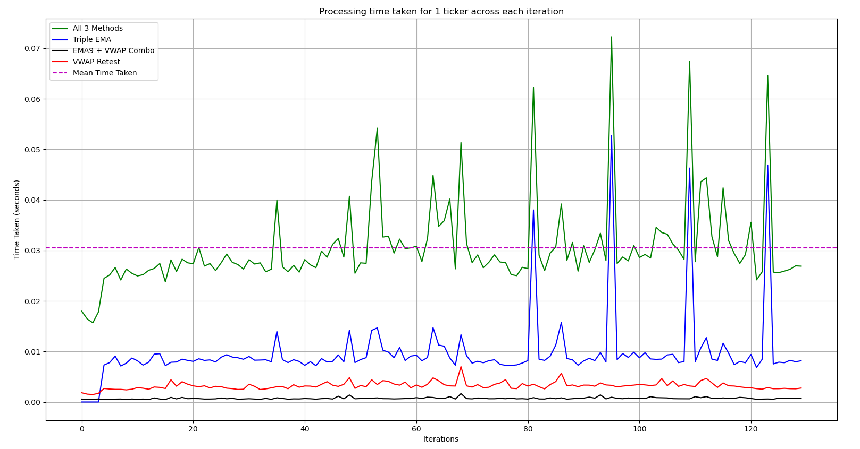
Processing Time
Objective: Understand how much time is required to analyze the 3 different intraday strategy for 1 ticker
Considerations: Imagine you have too huge of a list to analyze through. The first cut is to understand what is the maximum number tickers for every 3 minutes of processing
Observations:
Through the charts, we see that Triple EMA method has occasional spikes whereby the other two methods (EMA9+VWAP and VWAP retest) are quite consistent in term so processing time.
On average the time taken per iteration for 1 ticker is ~ 0.0305 seconds
In 3 minutes (180 seconds), based on the 0.0305 seconds per ticker, we can compute our analysis across 5901 tickers.
Currently, the number of tickers to be monitored is around 120-150 max. As such, it will only takes 4.575 seconds to process through 150 tickers. However, this does not take into consideration of the time required to download the live data (would need to test live during trade hours)

Slide 16
Processing Flow Chart
Start of program (run once)
Iteratively (interval basis)
Dashboard
Output to dashboard
Retrieve tickers from watchlist.csv (exported from trading view)
Dictionary of tickers + dataframes
VWAP Retest
Save result_df to dictionary
Create a dictionary of tickers + dataframes
EMA9 + VWAP Crossover
For ticker_ symbol in watchlist
e.g. Ticker “MSFT"
Triple EMA

Slide 17
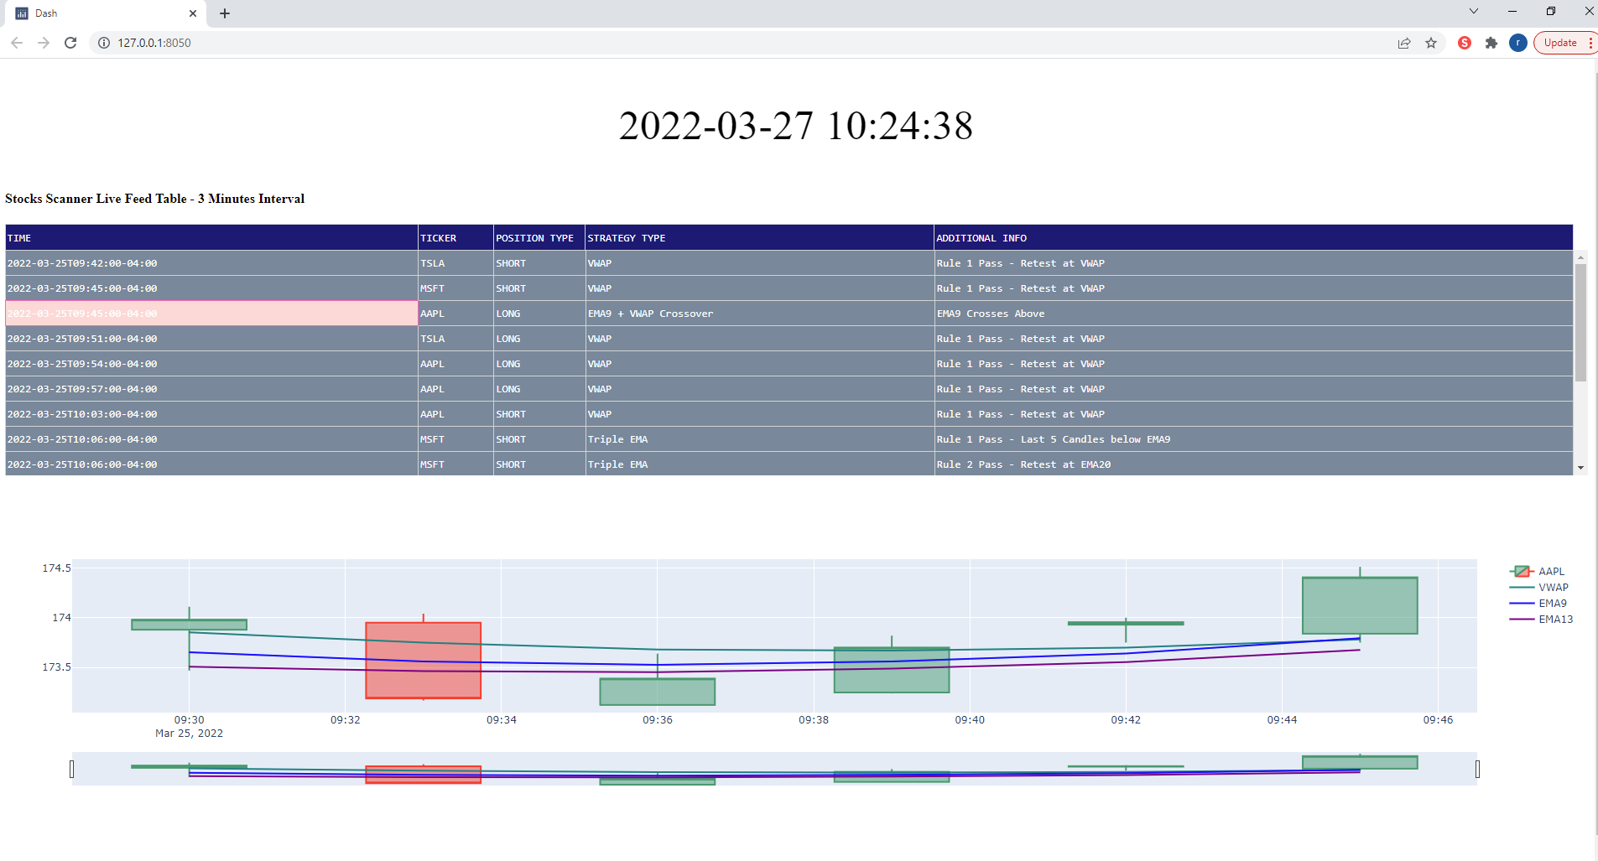
Dashboard

